Slide 1
Consumer Behavoir Analysis
File created on: 12/30/24 9:35:42 PM EST

Slide 2
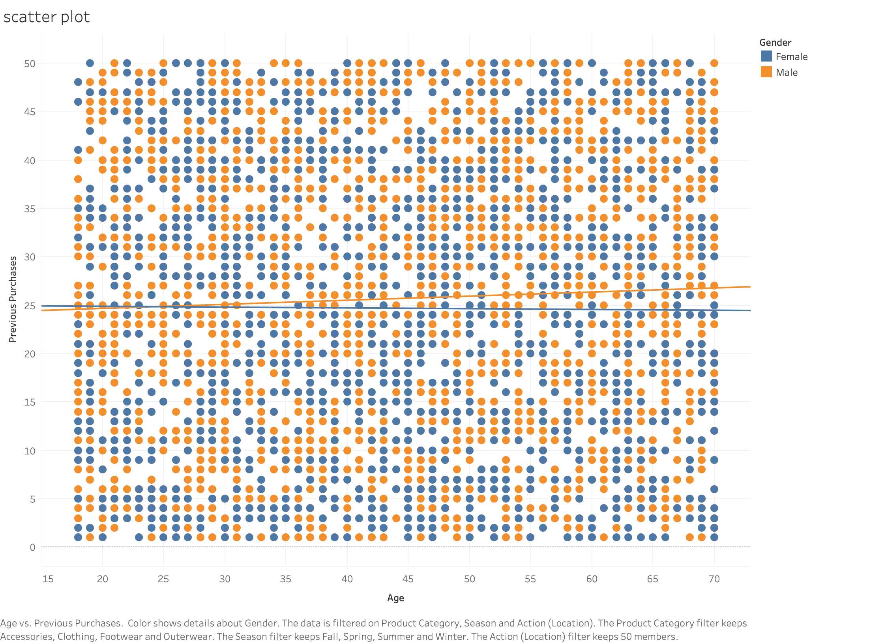

Slide 3
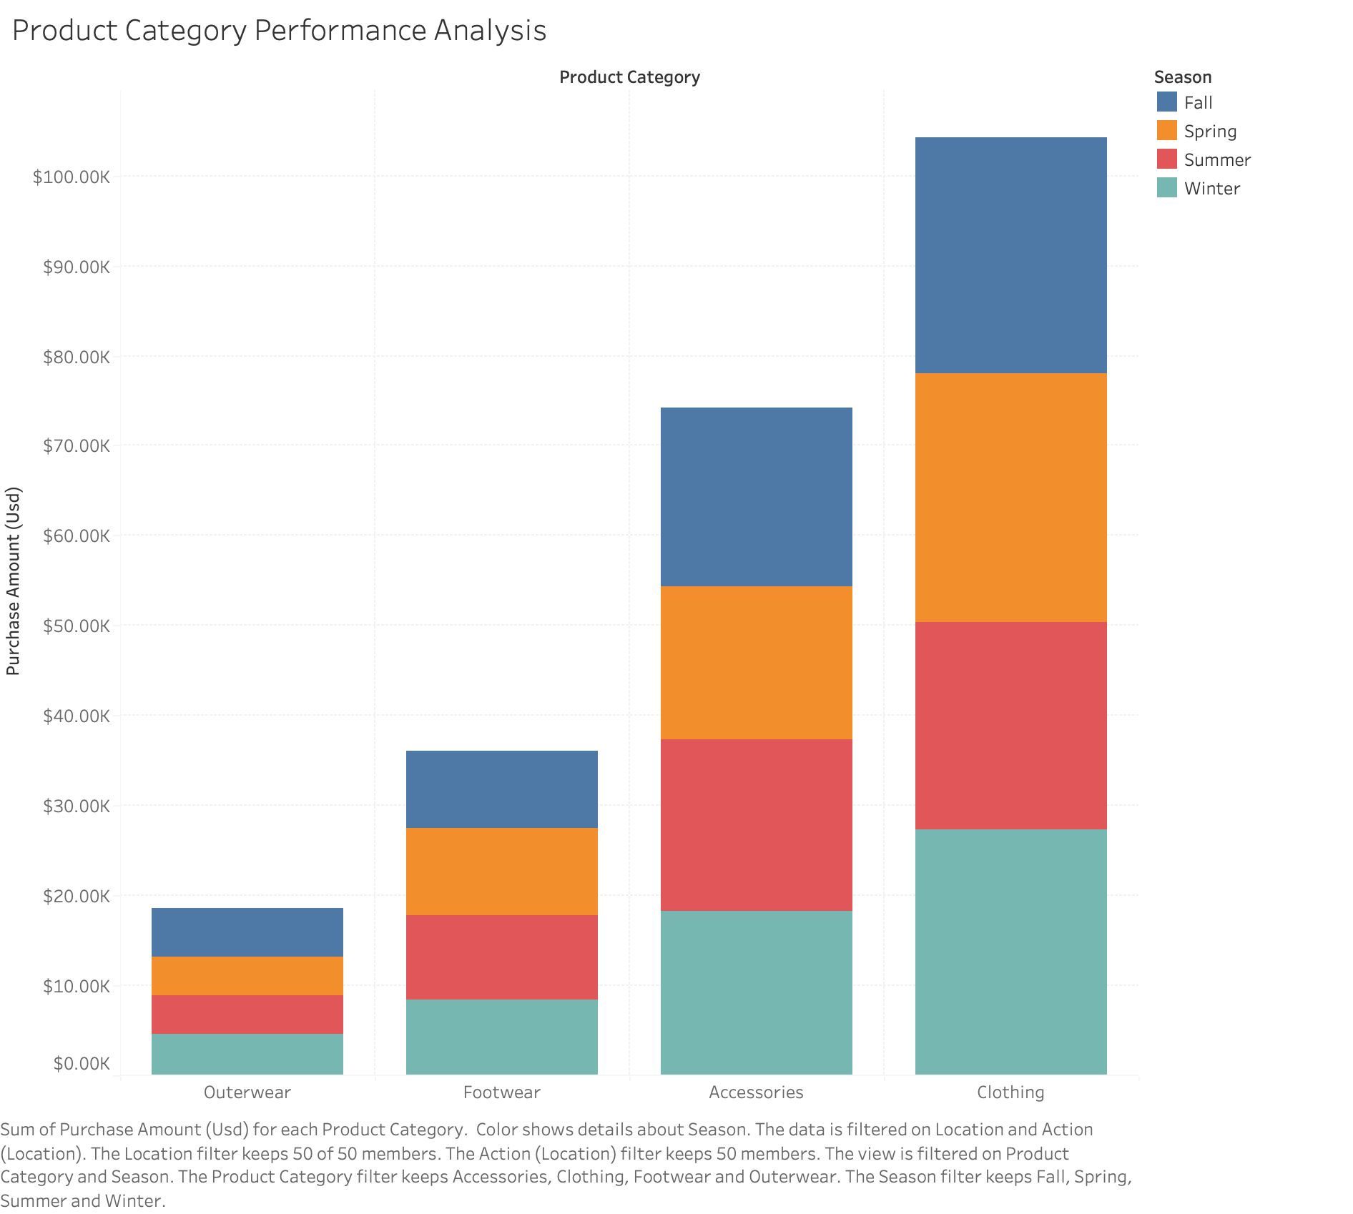

Slide 4
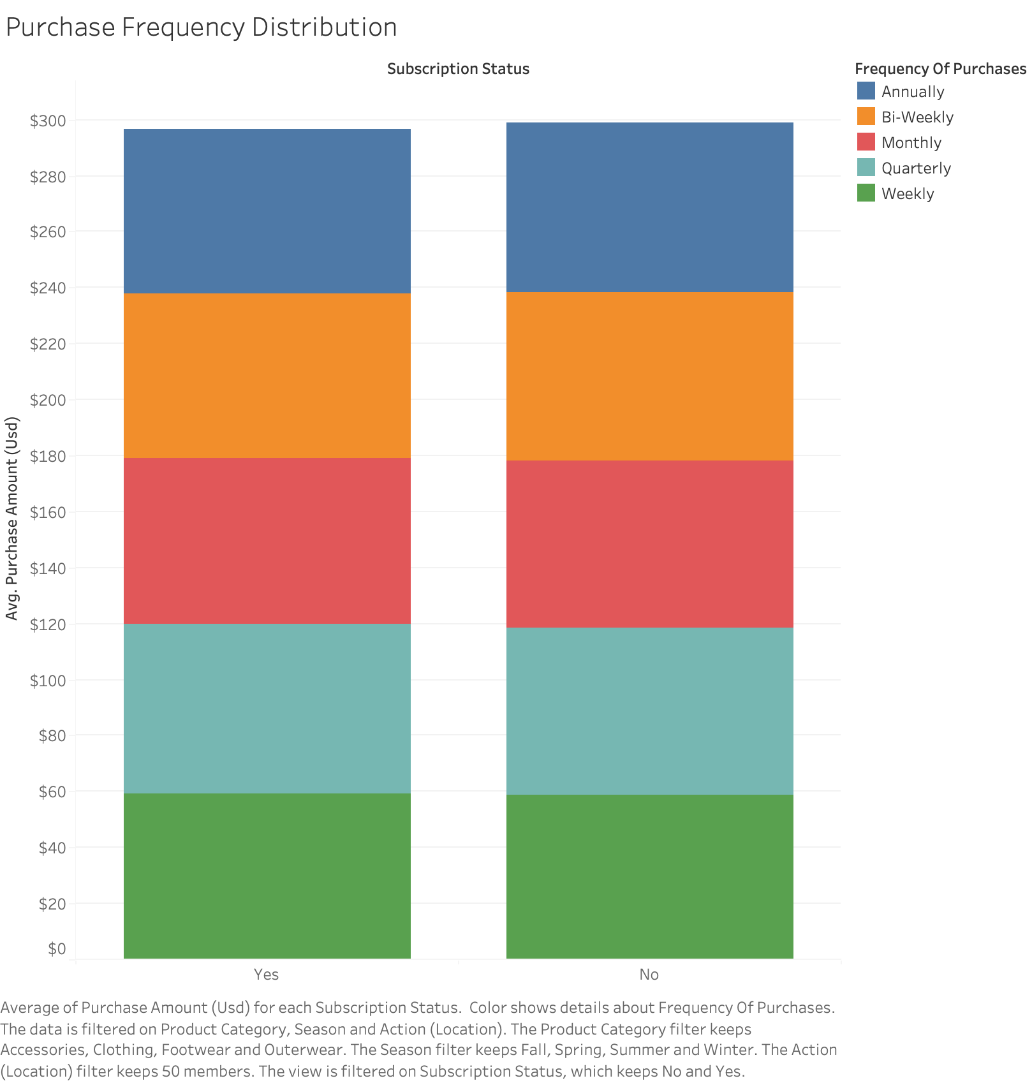

Slide 5
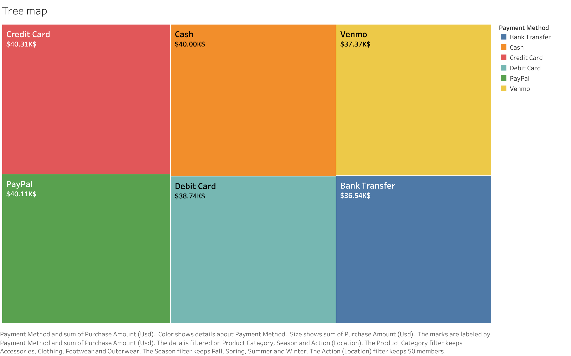

Slide 6
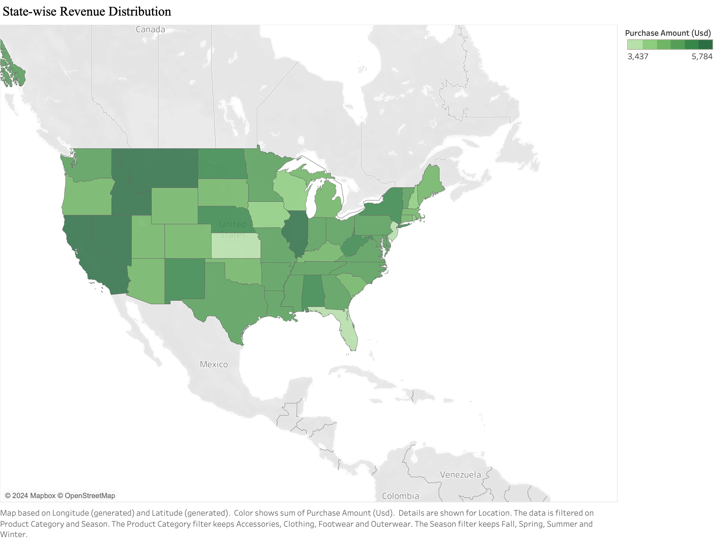

Slide 7
